Slide 1
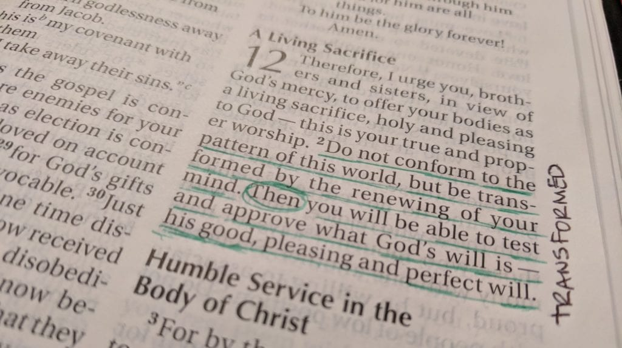
TRANSFORMED
A STUDY OF
ROMANS

Slide 2
ROMANS 16

Slide 3
https://youtu.be/0SVTl4Xa5fY?t=8m29s

Slide 4
What will you be known for?
Romans 16

Slide 5
SERVANT
Romans 16:1
I commend to you Phoebe our sister, who is a servant of the church in Cenchrea,
Mark 10:45
For even the Son of Man did not come to be served, but to serve, and to give His life a ransom for many.”
Philippians 2:5
Let this mind be in you which was also in Christ Jesus
WHAT WILL YOU BE KNOWN FOR?

Slide 6
SERVANT
Do you start each day thinking about how you can meet YOUR needs or the needs of OTHERS?
Romans 12:6
Having then gifts differing according to the grace that is given to us, let us use them
1 Corinthians 12:4-7
There are diversities of gifts, but the same Spirit. ⁵ There are differences of ministries, but the same Lord. ⁶ And there are diversities of activities, but it is the same God who works all in all. ⁷ But the manifestation of the Spirit is given to each one for the profit of all:
WHAT WILL YOU BE KNOWN FOR?

Slide 7
Risk-Taker
Romans 16:3-4
Greet Priscilla and Aquila, my fellow workers in Christ Jesus, ⁴ who risked their own necks for my life, to whom not only I give thanks, but also all the churches of the Gentiles.
Romans 12:1
I beseech you therefore, brethren, by the mercies of God, that you present your bodies a living sacrifice, holy, acceptable to God, which is your reasonable service.
WHAT WILL YOU BE KNOWN FOR?

Slide 8
Risk-Taker
When is the last time YOU risked anything for Christ and His kingdom?
WHAT WILL YOU BE KNOWN FOR?

Slide 9
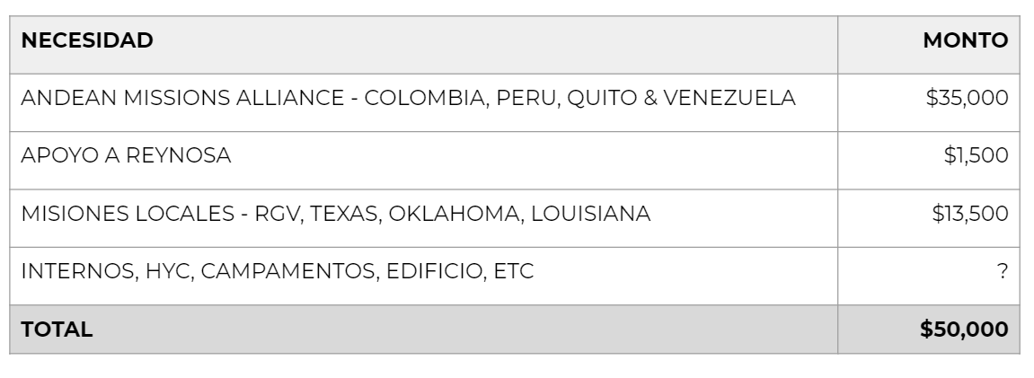
Special Missions Offering – May 26, 2019
WHAT WILL YOU BE KNOWN FOR?

Slide 10
Risk-Taker
According to OpenDoorUSA.org, reported January 2019:
1,266: churches or Christian buildings attacked in the top 50 World Watch List (WWL) countries.
11: Christians killed every day for their faith, in the top 50 WWL countries.
245 Million: In the top 50 WWL countries alone, 245 million Christians in the world experience high levels of persecution for their choice to follow Christ.
WHAT WILL YOU BE KNOWN FOR?

Slide 11
Risk-Taker
When is the last time YOU risked anything for Christ and His kingdom?
What will you RISK for Christ and His kingdom this week? This month? This year?
WHAT WILL YOU BE KNOWN FOR?

Slide 12
Fellow Worker
Romans 16:9
Greet Urbanus, our fellow worker in Christ, and Stachys, my beloved.
Hebrews 6:10
For God is not unjust to forget your work and labor of love which you have shown toward His name, in that you have ministered to the saints, and do minister.
WHAT WILL YOU BE KNOWN FOR?

Slide 13
Fellow Worker
Luke 10:2-3
Then He said to them, “The harvest truly is great, but the laborers are few; therefore pray the Lord of the harvest to send out laborers into His harvest. ³ Go your way; behold, I send you out as lambs among wolves.
If you worked for your current employer the same way you work for the kingdom, would you still have a job?
WHAT WILL YOU BE KNOWN FOR?

Slide 14
APPROVED IN CHRIST
Romans 16:10
Greet Apelles, approved in Christ.
Ephesians 1:3-6
Blessed be the God and Father of our Lord Jesus Christ, who has blessed us with every spiritual blessing in the heavenly places in Christ, ⁴ just as He chose us in Him before the foundation of the world, that we should be holy and without blame before Him in love, ⁵ having predestined us to adoption as sons by Jesus Christ to Himself, according to the good pleasure of His will, ⁶ to the praise of the glory of His grace, by which He made us accepted in the Beloved.
WHAT WILL YOU BE KNOWN FOR?

Slide 15
APPROVED IN CHRIST
1 John 3:19-20
And by this we know that we are of the truth, and shall assure our hearts before Him. ²⁰ For if our heart condemns us, God is greater than our heart, and knows all things.
2 Corinthians 13:5-6
Examine yourselves as to whether you are in the faith. Test yourselves. Do you not know yourselves, that Jesus Christ is in you?—unless indeed you are disqualified. ⁶ But I trust that you will know that we are not disqualified.
WHAT WILL YOU BE KNOWN FOR?

Slide 16
APPROVED IN CHRIST
Do you let thoughts of inadequacy tarnish your witness for Christ?
WHAT WILL YOU BE KNOWN FOR?

Slide 17
Obedience
Romans 16:19
For your obedience has become known to all. Therefore I am glad on your behalf; but I want you to be wise in what is good, and simple concerning evil.
WHAT WILL YOU BE KNOWN FOR?

Slide 18
Obedience
Isn’t this what we all signed up for?
WHAT WILL YOU BE KNOWN FOR?

Slide 19
Obedience
Isn’t this what we all signed up for?
Matthew 28:20
teaching them to observe all things that I have commanded you; and lo, I am with you always, even to the end of the age.
John 14:15
“If you love Me, keep My commandments.”
WHAT WILL YOU BE KNOWN FOR?

Slide 20
Keys of Obedience
Environment (v17)
Serve Jesus, not our own desires (v18)
Wise in good, simple concerning evil (v19)
God’s grace (v20,24)
Faith (v25-27)
WHAT WILL YOU BE KNOWN FOR?

Slide 21
TRANSFORMED
Romans 16:25-27
Now to Him who is able to establish you according to my gospel and the preaching of Jesus Christ, according to the revelation of the mystery kept secret since the world began ²⁶ but now made manifest, and by the prophetic Scriptures made known to all nations, according to the commandment of the everlasting God, for obedience to the faith— ²⁷ to God, alone wise, be glory through Jesus Christ forever. Amen.
Romans 5:2
…through whom also we have access by faith into this grace in which we stand, and rejoice in hope of the glory of God.
WHAT WILL YOU BE KNOWN FOR?

Slide 22
TRANSFORMED
Romans 16:25-27
Now to Him who is able to establish you according to my gospel and the preaching of Jesus Christ, according to the revelation of the mystery kept secret since the world began ²⁶ but now made manifest, and by the prophetic Scriptures made known to all nations, according to the commandment of the everlasting God, for obedience to the faith— ²⁷ to God, alone wise, be glory through Jesus Christ forever. Amen.
Romans 5:2
…through whom also we have access by faith into this grace in which we stand, and rejoice in hope of the glory of God.
Ephesians 2:8
For by grace you have been saved through faith, and that not of yourselves; it is the gift of God
WHAT WILL YOU BE KNOWN FOR?

